Slide 1
Optimal Control of
Beer Fermentation
W. Fred Ramirez

Slide 2
Summary
Using the mathematical model of beer fermentation of Gee and Ramirez (1988, 1994), this work uses the optimization technique of sequential quadratic programming for determining the optimal cooling policies for beer fermentation, Ramirez and Maciejowski (2007).

Slide 3
Beer Flavor Model
Growth Model, Engasser et al. (1981)
Three basic sugars are considered for consumption
Glucose
(1)
Maltose
(2)
Maltotriose
(3)

Slide 4
The specific growth rates are given below and show that the maltose specific growth rate is inhibited by glucose, and that for maltotriose is inhibited by both glucose and maltose:

Slide 5
The temperature dependency of these specific growth rates are

Slide 6
The biomass production rate includes an inhibition term in the biomass concentration as discussed by Gee and Ramirez (1994):
The ethanol production is assumed to be proportional to the amount of sugars consumed

Slide 7
The batch temperature (T) is given by an energy balance which includes the heat of reaction effects and the cooling capacity which is control on the process.
Here u is the control variable of the cooling rate per volume per degree, and
is the coolant temperature.

Slide 8
Nutrient Model
Amino acids have been shown to affect the formation of flavor compounds (Ayrapaa, 1961). Therefore, a specific nutrient model is used for the amino acids of leucine (L), isoleucine (I) and valine (V). The amino acid assimilation is assumed to be negatively proportional to the growth rate, limited by the availability of the amino acid in the media and with a lag phase at the beginning of fermentation.

Slide 9
Fusel Alcohols Fusel alcohols are undesirable species since they contribute a plastic, solvent like flavor and are suspected to contribute to negative physiological symptoms. The model assumes production proportional to the appropriate amino acid uptake rate (Gee and Ramirez, 1994). The fusel alcohols considered are isobutyl alcohol (IB), isoamyl alcohol (IA), 2-methyl-1-butanol (MB), and propanol (P).

Slide 10
Esters Esters are desirable flavor compounds since they contribute a great deal to beer aroma and add a full bodied character to beer. Three esters are considered in the model and are ethyl acetate (EA), ethyl caproate (EC) and isoamyl acetate (IAc). They are modeled as proportional to either sugar consumption rates or biomass growth rate or appropriate fusel alcohol consumption rate.

Slide 11
Vicinal Diketones Vicinal diketones (VDK) are considered undesirable flavor compounds in high concentrations. They add a buttery flavor to beer. All vicinal diketones are lumped together as one flavor species and are assumed to be produced proportional to the growth rate and consumed proportional to their own concentration.
Acetaldehyde Acetaldehyde (AAl) exhibits similar dynamics to that of VDK in that it is produced early in the fermentation and then consumed later in the fermentation. Acetaldehyde contributes a grassy flavor to beer and high concentrations are not desirable

Slide 12
Sequential Quadratic Programming
Sequential quadratic programming is known to be a very effective and efficient means of optimization of systems with constraints. The main draw back is that it tends to converge to local rather than global optima. If a good initial guess is available then this method is an excellent choice for direct dynamic optimization.

Slide 13
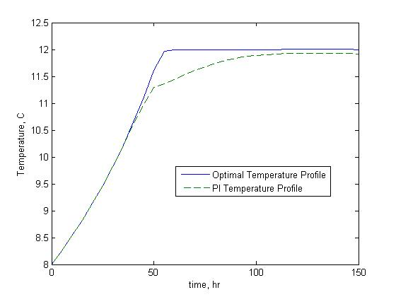
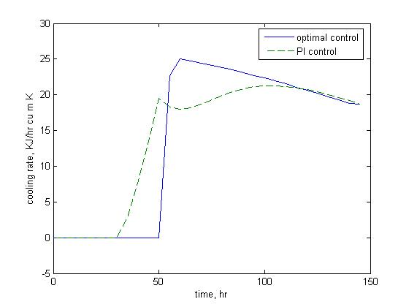
Optimal Control Using a Growth Model
Ramirez and Gee, 1988; Ramirez and Maciejowski, 2007
We used an upper constraint on the cooling capacity of 40 KJ/hr cu m K and a lower bound of zero. We also employ the nonlinear inequality constraint that the system temperature must be less than or equal to a maximum temperature.

Slide 14
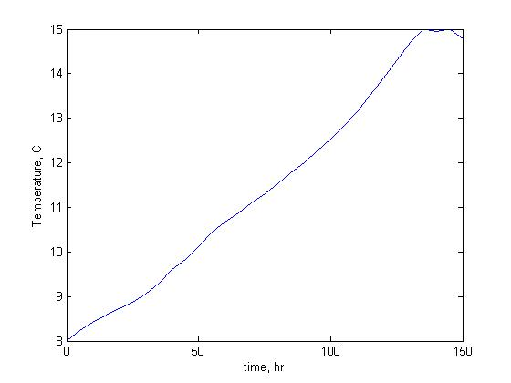
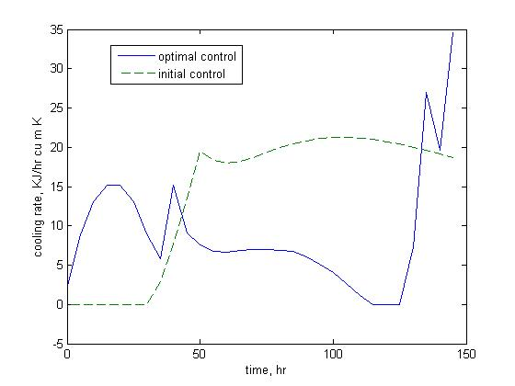
Optimal Flavor Control
These optimal conditions resulted in a final ethanol concentration of 762.2 gmole/ cu m which is a 4.8% improvement over the optimal growth value. The new optimal fusel alcohol concentrations sum to 1.505 which is slightly lower than the growth value of 1.507.
In addition, these optimal conditions resulted in an increase in ester production from 0.2379 gmole/ cu m to 0.2479 gmole/ cu m. This is an increase of 3.8% in the production of flavor enhancing esters.
The only draw back with this strategy is that the acetaldehyde final concentration is actually increased by 7.6% and this could give the beer too grassy a flavor.

Slide 15
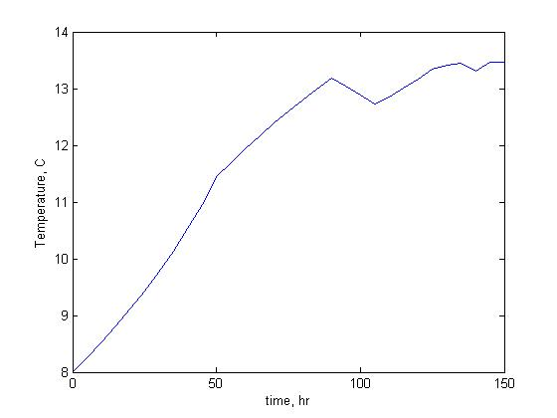
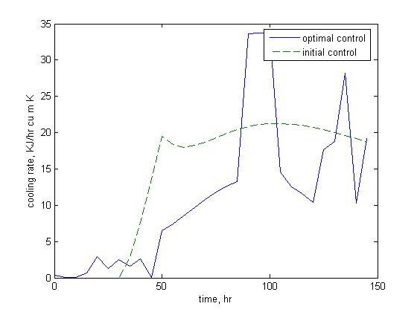
Optimal Flavor Control
The optimal results have an increase in the final ethanol concentration of 6.2%, an increase in the final ester concentration of 4.6%, a fusel alcohol concentration that stays the same, a decrease in the final VDK concentration of 26.7% and a slight increase in the final acetaldehyde concentration of 1.27%.
The values of C1 and C2 can significantly change the results. When they are low the optimal growth policy is obtained which results in excess production of fusel alcohols (1.7%) and acetaldehyde (2.3%). When they are too large the system is excessively cooled resulting in a 40% reduction in ethanol production.

Slide 16
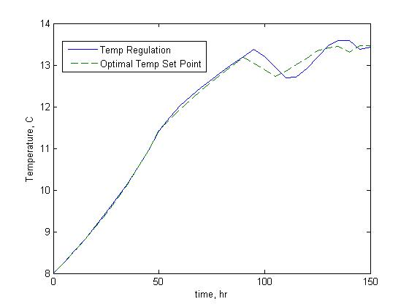
Implementation
We investigated the regulation of the system using a tracking PI controller about the optimal temperature profile. A velocity mode for the PI algorithm is used,

Slide 17
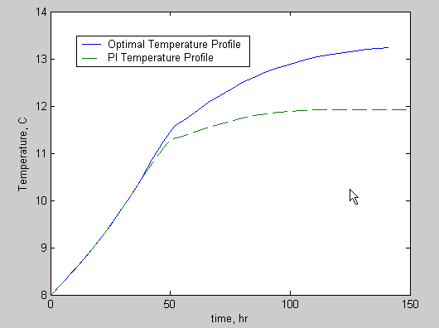
Maximize Production While Maintaining Product Quality
Time – From 150 to 141 hrs
Reduction of 5.8%
Ethanol – Increase by 0.44%
Fusel Alcohols – Increase by 0.16%
Esters – Increase by 1.47%
Acetaldehyde – Increase by 6.5%

Slide 18
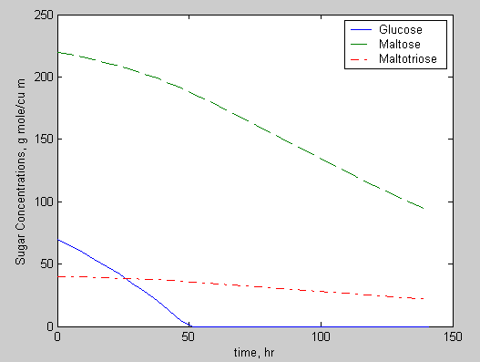
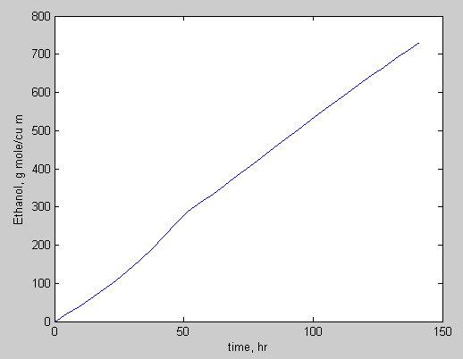
Optimal Productivity Profiles
Optimal Sugar Consumption
Optimal Ethanol Production

Slide 19
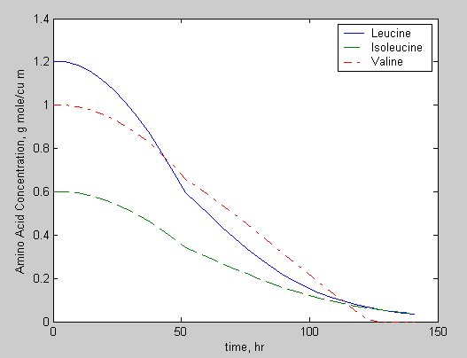
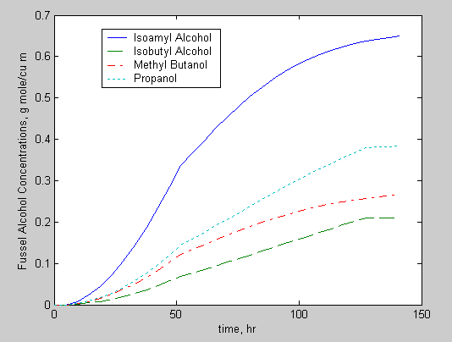
Optimal Productivity Profiles
Optimal Amino Acid Consumption
Optimal Fusel Alcohol Production

Slide 20
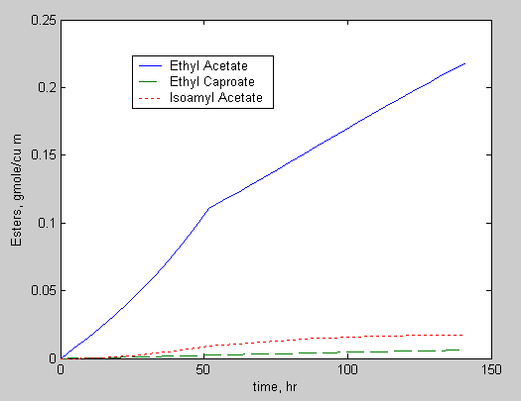
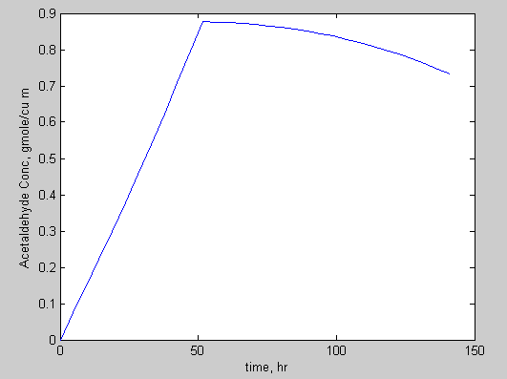
Optimal Productivity Profiles
Optimal Ester Production
Optimal Acetaldehyde Production

Slide 21
Modeling and Optimization
Work Required
Using nonlinear regression find model parameters for a specific beer data set of four isothermal runs
Determine optimal temperature profiles for desired objectives

Slide 22
Typical Uses for Optimization Tool
Product Improvement
  Increase ethanol w/o impacting quality
  Reduce fusel alcohols w/o impacting esters
  Increase esters w/o impacting acetaldehyde
Improve Productivity
  Similar quality beer in less time
Batch to Batch Consistency
  Consistent beer profile with variable initial conditions
    Higher initial temperature (1⁰C)
    Lower inoculums (20% less yeast)
Flavor matching going to a new or different plant
  Develop model parameters for each plant
  Keep product quality consistent between plants

